Slide 1
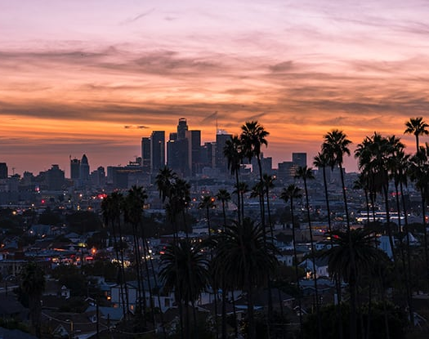
Los Angeles
Borsos Ferenc

Slide 2
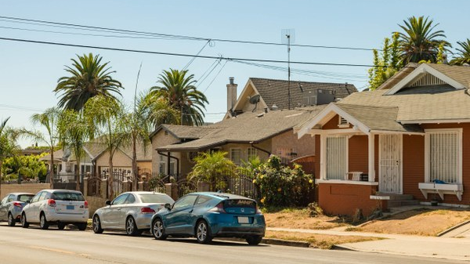
Is Los Angeles famous for?
Los Angeles is known for its amusement parks, Hollywood culture, beautiful neighborhoods and eclectic artistic spirit. Los Angeles is the largest city in California, sitting just off the Pacific Coast of the United States.

Slide 3
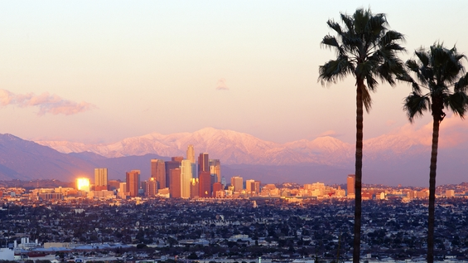
The city was officially founded on April 4, 1850, with a population of only 1,610, and it also became the seat of Los Angeles County.
According to the data of the last comprehensive census conducted in 2012, the number of its inhabitants is 3,831,868.
The population of the entire agglomeration (Metropolitan Area) is 17,545,623. The city is also large in a geographical sense, as it occupies more than 1,200 km², making it larger than New York and Chicago.

Slide 4
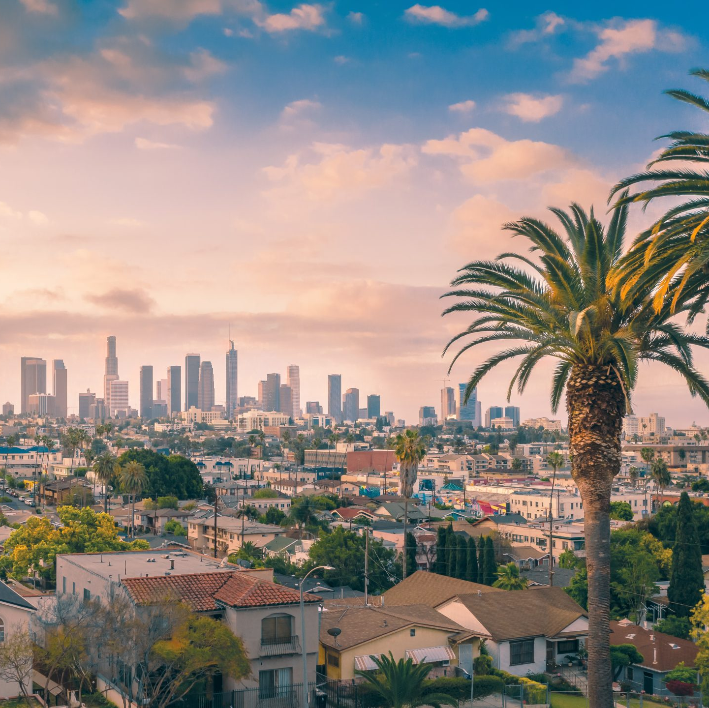
History
The city of Los Angeles was officially founded in 1850, when its population was 1,610. The railway reached the city in 1876. In 1892, crude oil was found in the area, and by 1923, Los Angeles accounted for a quarter of the world's crude oil production.
However, water was more important for the development of the city. Under the direction of William Mulholland, the Los Angeles Aqueduct was completed by 1913, a 223-mile-long aqueduct that carried water from the Owens River to the city.
The city's explosive growth after 1915 can primarily be attributed to this. Although the builders and the whole idea were later criticized, it is certain that the size and importance of Los Angeles would not be a fraction of what it is today without the aqueduct.

Slide 5

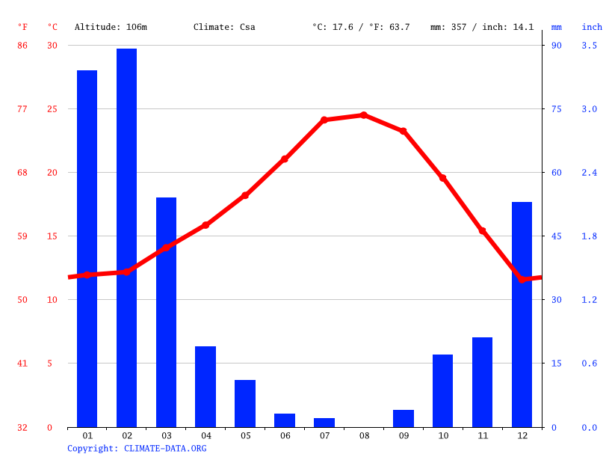
Climate
Los Angeles is located in the Mediterranean belt, characterized by mild wet winters, warm or hot, dry summers. In the coastal areas of Los Angeles and San Diego, ocean breezes result in more balanced weather, milder winters, and cooler summers than areas farther from the coast. In summer, the temperature can rise well above 30 °C, and smog can cause a particular problem.

Slide 6

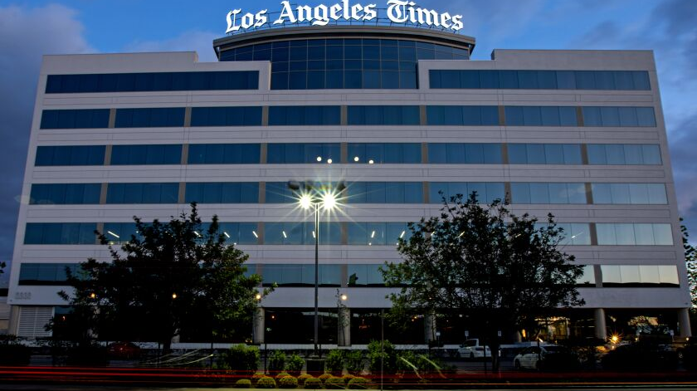
Arts and entertainment
Los Angeles is the capital of the world's rain industry, from downtown, the name of the NENY Hollywood neighborhood is synonymous with Hollywood film production. It shares the title of cultural capital within the country with New York. The most important branch of the entertainment industry is film production, but it is also an important center for music, visual arts and architecture.

